Slide 1


Ministry of Higher Education, Research and Innovation
TOPIC : development of an e-commerce platform for the sale of farm products in Burkina Faso
Presented and publicly defended:
Ebou NEBIE
Promotion 2020-2023
Notes:
Your Excellency, the president of the jury, honorable jury members, first of all, receive our words of welcome and thanks for having accepted, despite your occupations, to devote yourself to the assessment of our research work results.
With your permission, we would also like to express our sincere gratitude to all those who mobilized by making the trip to this place of knowledge to show us their support.

Slide 2
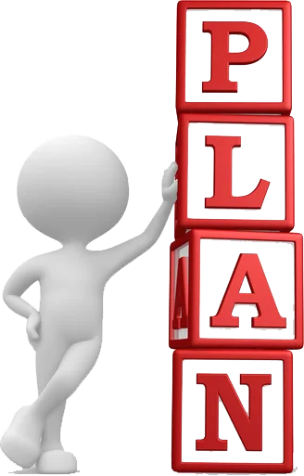
Plan
Introduction
Problematic
Objectives
Existing system
Methodology
Modeling and design
Implementation and results
Conclusion
Notes:
In the plan ,we have first introduction then problematic, objectives ,existing system methodology modeling and design implementation and results finally conclusion

Slide 3
Introduction
Employs about 86% of the active population.
Contributing about 30% to the Gross Domestic Product(GDP)
It constitutes the main source of income for the majority of the population
The launch of the Agro-Sylvo-Pastora sector support program(PAFASP) aims to enhance the competitiveness of Agro-Pastoral products in the market
However market growth remains relatively low due to limited market access
Costly intermediaries/logistical challenges

Slide 4
Problematic
What are the main obstacles to the growth of the agricultural products market?
How can we increase the visibility of agricultural products in the market?
What marketing and promotional strategies can be used to capture consumers’ attention for the products?

Slide 5
Objectives
The trageted objectives of this study are as follows
Promote agricultural and rural development
Increase the visibility and accessibility of agricultural product
Expand the customer base and reach new markets
Enhance transparency and product traceability
Optimize the supply chain

Slide 6
Existing system
Agri-yaar <agricultural market> is a web platform that promotes agricultural products, but not all agricultural products, only the seasonal vegetables

Slide 7
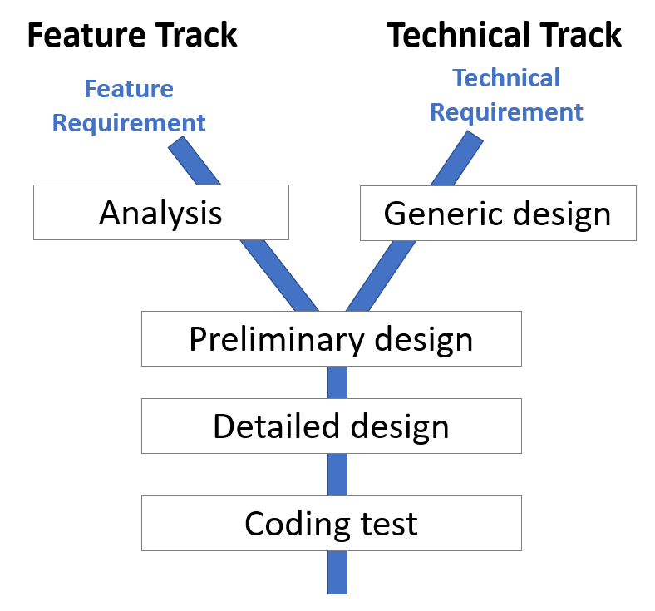
Methodology 1/3
Two Track Unified Process
Notes:
To meet the functional, technical, and quality requirements of this project, we have chosen the Two Tracks Unified Process (2TUP) approach, which offers a development cycle in the shape of a Y, separating technical aspects from functional ones. It emphasizes technology and risk management

Slide 8
Methodology 2/3
Capture of needs
Feature requirement
Technical requirement
Notes:
The system implementation phase involves merging the results of the two branches, which are:

Slide 9

Methodology 3/3
The different programing languages
Notes:
Our platform is developed in Python using the Django framework. Its purpose is to create robust and secure web applications. We also utilize Bootstrap, which employs HTML/CSS and JavaScript, to build an application that can operate on any website. We use jQuery to communicate directly with the server without refreshing.

Slide 10
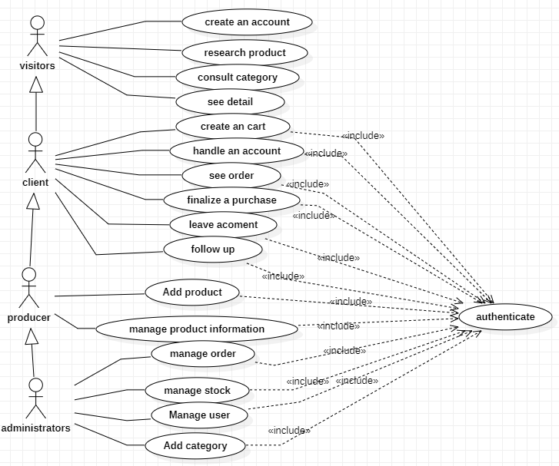
Modeling and design 1/4
Global use case diagram
Notes:
Visitors can create an account, search for a product, view details, and consults categories without being authenticated. Clients, producers, and administrators can perform additional actions after being authenticated.

Slide 11
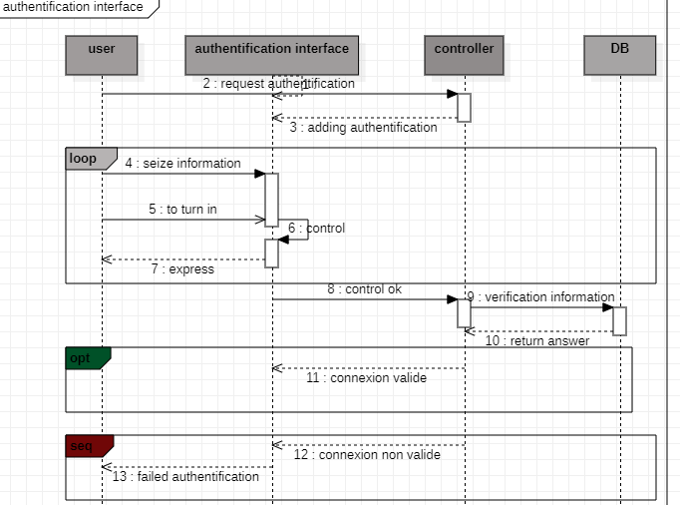
Modeling and design 2/4
Sequence diagram’authentification
Notes:
The user requests the authentication interface, and the system sends back the authentication interface. The user enters their information and submits it. The system checks and displays an exception if the control fails. If the control is okay, it verifies the information in the database and returns the response "valid connection." Otherwise, it returns "invalid connection.

Slide 12
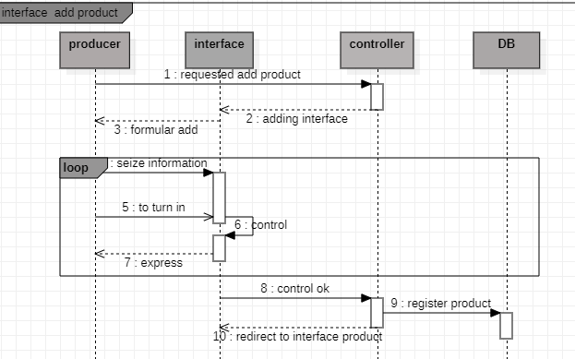
Modeling and design 3/4
Sequence diagram ’interface add product’

Slide 13
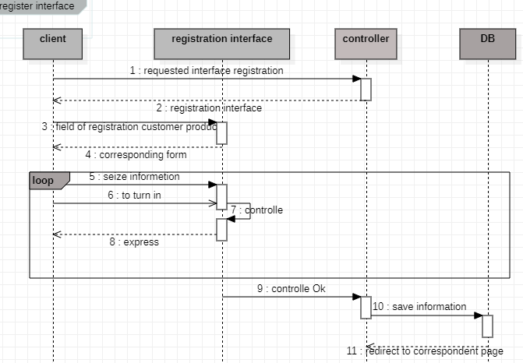
Modeling and design 4/4
Séquence diagram’register interface

Slide 14
Implementation and results 1/3
Implementation
Implementation in the process concerns the last branch (middle branch) of the Two Tracks Unified Process , whose objective is to materialize a design model in application layers and the human-machine interface (HMI) and then test it.

Slide 15
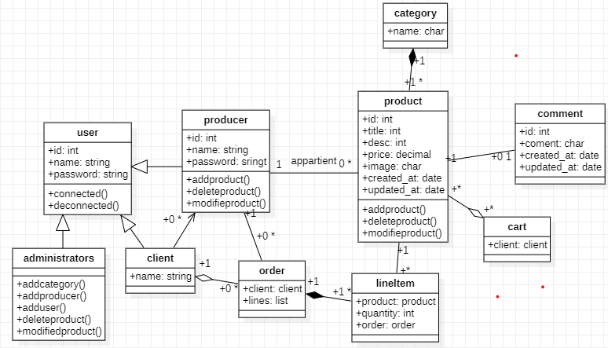
Implementation and results 2/3
Global class diagram
Notes:
The User class contains various user information. A user can be a customer, an administrator, or a producer. The Producer class is linked to the Client class by zero or more clients and is linked to the Command class by zero or more orders. A order belongs to a producer. The Producer class is also linked to the Product class by zero or more products, and a product belongs to a producer. The Product class is linked to the LineItem class by multiple LineItems, and each LineItem is associated with a producer. The LineItem class is connected to an order. An order can have one or more LineItems. An order belongs to a customer, and a customer can place zero or more orders. A category belongs to a product, and a product belongs to a category. A product can have zero or more comments, and each comment belongs to a product. A cart is linked to multiple products, and a product can be associated with multiple carts

Slide 16
Implementation and results 3/3
Results

Slide 17
Conclusion
Notes:
The agricultural sector plays a crucial role in Burkina Faso's economy, making a significant contribution to the country's GDP and creating economic opportunities for rural populations. In this context, this final-year project aims to address the visibility and market growth challenges facing agricultural products in Burkina Faso by establishing an e-commerce platform dedicated to their sale.

Slide 18
THANK YOU for your attention.

